Slide 1
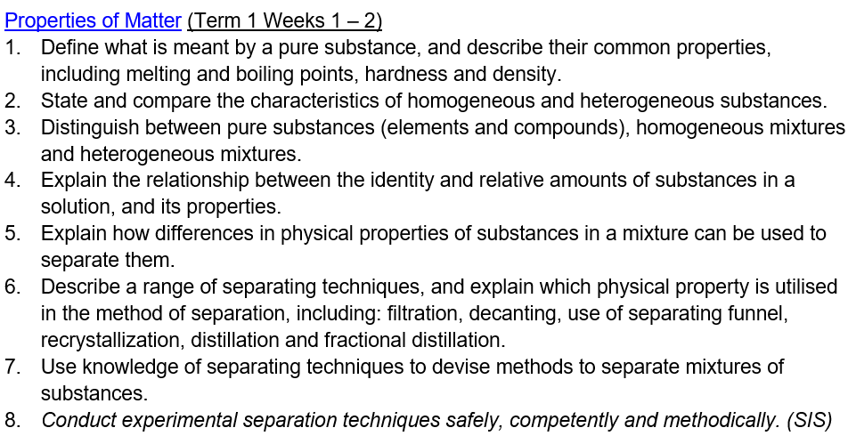

Slide 2
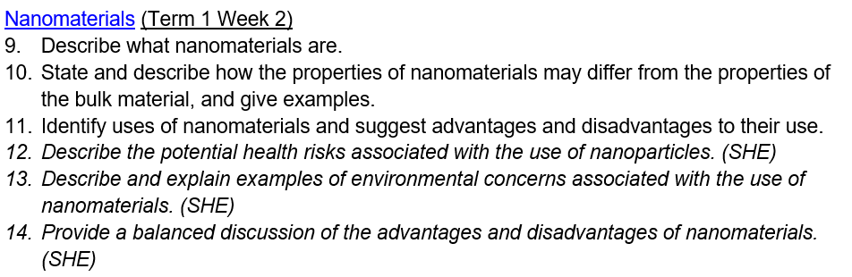

Slide 3
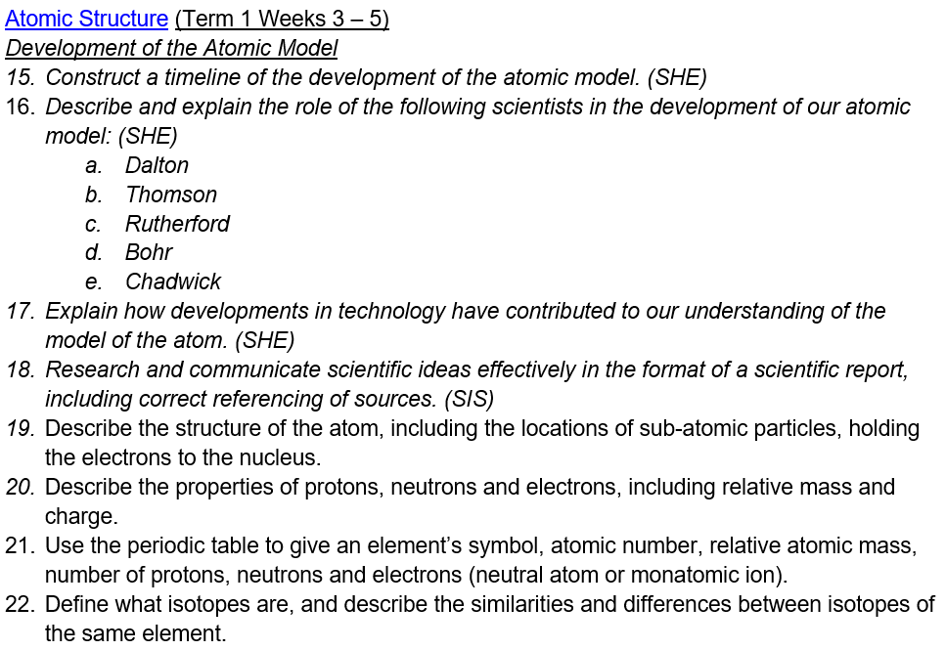

Slide 4
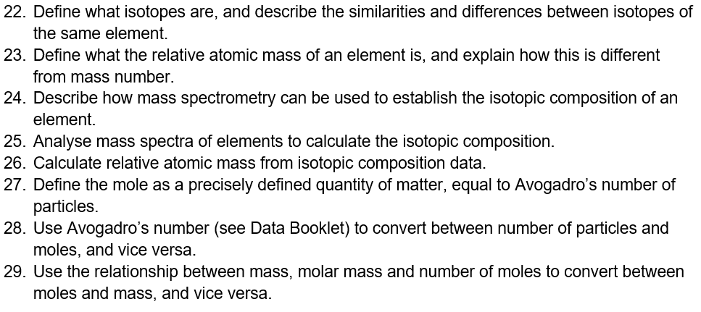

Slide 5
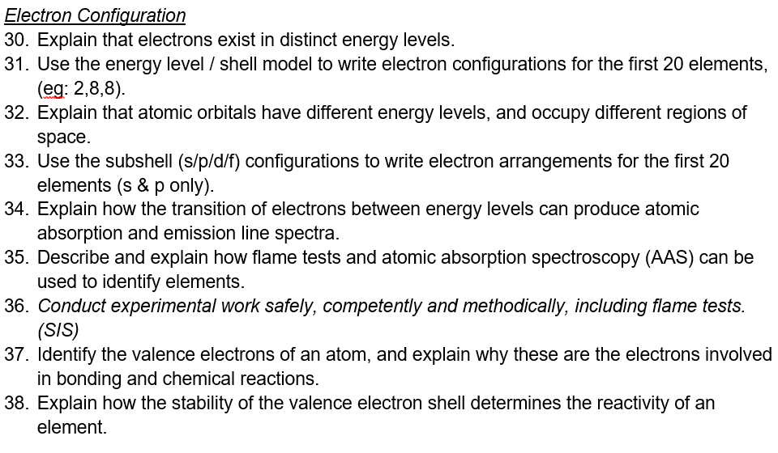

Slide 6
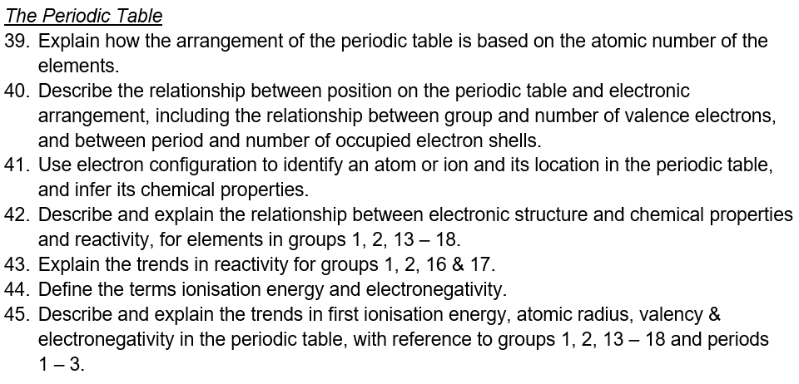

Slide 7
1.4 Atomic Structure
Nelson 1.1-1.3
Lucarelli Ch 2
STAWA Set 8

Slide 8
Atomic Structure
Objectives:
Explain how findings from experiments contributed to our understanding of the atom (CAT).
Describe the structure of the atom and the arrangement of its subatomic particles.
Describe the similarities and differences between isotopes of the same element.

Slide 9
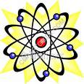
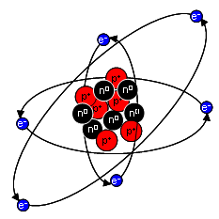
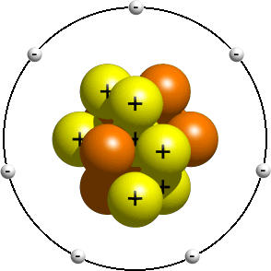
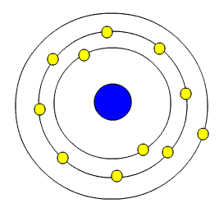
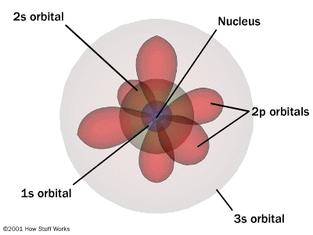
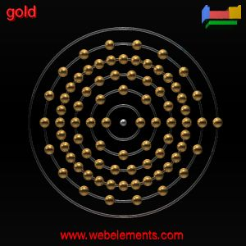

Slide 10
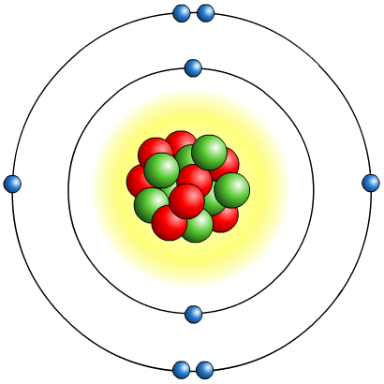

What is the structure of an atom?
Protons, neutrons and electrons are not evenly distributed in an atom.
Most the of the volume of the atom is empty space.
The protons and neutrons exist in a dense core at the centre of the atom. This is called the nucleus.
It is held together by the strong nuclear force.
The electrons are spread out around the edge of the atom. They surround the nucleus in layers called shells or energy levels.

Slide 11

Subatomic particles
Atoms are composed of three subatomic particles: protons, neutrons and electrons. The two important properties of these particles are mass and charge:
Particle
Relativemass
Relative charge
proton
1
+1
neutron
1
0
electron
1/1840
-1
The mass of electrons is negligible when compared to the mass of protons and neutrons, so their mass is not included when calculating the mass of the atom.
Notes:
Teacher notes
Protons and neutrons are collectively called nucleons.
See the Boardworks ‘GCSE Additional Science: Physics: Radioactive Decay’ presentation for more information about the history of the discovery of atomic structure, including the work of Dalton, Thomson, Geiger, Marsden and Rutherford.

Slide 12
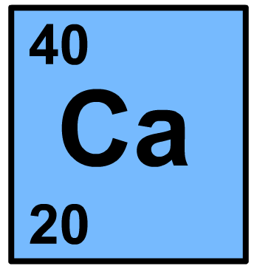
Atomic number and mass number
The number of protons in an atom is known as the atomic number or proton number and is represented by the symbol Z.
The mass number of an atom is the number of protons plus the number of neutrons, and is represented by the symbol A.
When an atom is represented by its symbol, the mass number, and sometimes the atomic number, are shown.
mass number (A)
atomic number (Z)
Notes:
Teacher notes It would be worth pointing out to students that ‘mass number’ and ‘relative atomic mass’ are not the same. Mass number (A) is the number of protons plus the number of neutrons and so is only even an integer. Relative atomic mass (A_{r}) is the mass of an atom relative to 1/12th the mass of one atom of carbon–12 and can be expressed to varying numbers of decimal place.
A = Z + neutrons

Slide 13
Atomic number and mass number
Z = N_{p}
A = N_{p} + N_{n}
N_{e} = N_{p} in a neutral atom
mass number (A)
atomic number (Z)
Notes:
Teacher notes It would be worth pointing out to students that ‘mass number’ and ‘relative atomic mass’ are not the same. Mass number (A) is the number of protons plus the number of neutrons and so is only even an integer. Relative atomic mass (A_{r}) is the mass of an atom relative to 1/12th the mass of one atom of carbon–12 and can be expressed to varying numbers of decimal place.
A = Z + neutrons

Slide 14
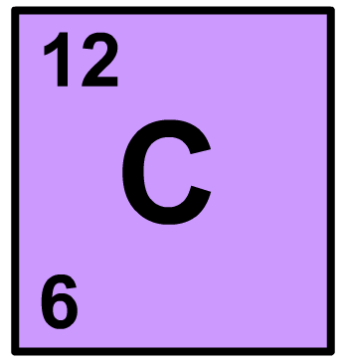
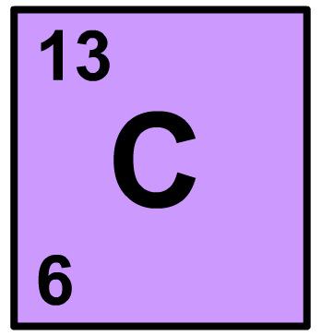
What are isotopes?
Isotopes are atoms of the same element that contain different numbers of neutrons.
mass number is different
atomic number is the same
carbon-12
carbon-13
The reactivity of different isotopes of an element is identical because they have the same number of electrons.
The different masses of the atoms means that physical properties of isotopes are slightly different (colour, density, mass, nuclear stability).
Heavy water: https://www.youtube.com/watch?v=VLiirA5ooS0
Notes:
A_{r} = (abundance x atomic mass) + (abundance x atomic mass) / 100
A = (99 x 12) + (1 x 13) / 100 = 12.01

Slide 15
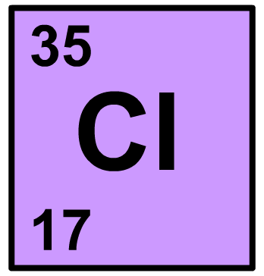

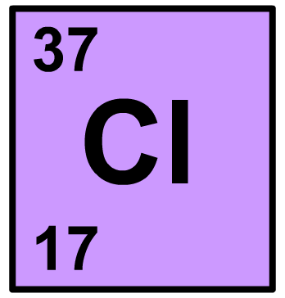


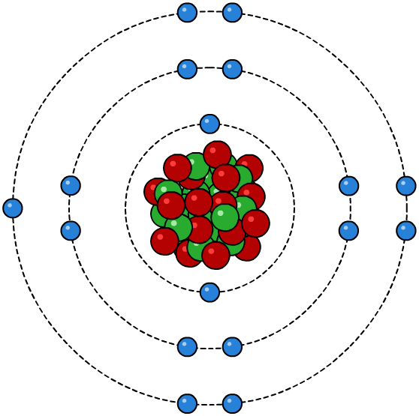

Isotopes of chlorine
About 75% of naturally-occurring chlorine is chlorine-35 (³⁵Cl) and 25% is chlorine-37 (³⁷Cl).
17 protons
17 protons
18 neutrons
20 neutrons
17 electrons
17 electrons
Notes:
= 35.5

Slide 16
Isotopes of carbon
There is also more than one isotope of carbon:
Isotope
Protons
Neutrons
¹²C
6
6
¹³C
6
7
¹⁴C
6
8
All isotopes of carbon have 6 protons and so have 6 electrons.
Because chemical reactivity depends on the number of electrons the reactivity of the isotopes of carbon is identical.

Slide 17
Consider these questions
1) What makes up most of the mass of the atom?
2) What makes up most of the space of the atom?
3) What stops the electrons whizzing off into space?
4) Which part of the atom causes radioactivity?
5) Which part of the atom does chemical reactions?

Slide 18
What are isotopes?
Isotopes are atoms of the same element that contain different numbers of neutrons.
mass number is different
atomic number is the same
carbon-12
carbon-13
The reactivity of different isotopes of an element is identical because they have the same number of electrons.
The different masses of the atoms means that physical properties of isotopes are slightly different (colour, density, mass, nuclear stability).
Heavy water: https://www.youtube.com/watch?v=VLiirA5ooS0
Notes:
A_{r} = (abundance x atomic mass) + (abundance x atomic mass) / 100
A = (99 x 12) + (1 x 13) / 100 = 12.01

Slide 19
Isotopes of chlorine
About 75% of naturally-occurring chlorine is chlorine-35 (³⁵Cl) and 25% is chlorine-37 (³⁷Cl).
17 protons
17 protons
18 neutrons
20 neutrons
17 electrons
17 electrons
Notes:
= 35.5

Slide 20
Warm-Up
How many molecules are present in 0.15 mol of ethanoic acid?
What is the mass (g) of 1.25 mol of Fe₂(SO₄)₃
Rhenium has two naturally occurring isotopes: ¹⁸⁵Re (37.4%) and ¹⁸⁷Re (62.6%). What is its average relative atomic mass?
*Lithium has a relative atomic mass of 6.968 and has two naturally occurring isotopes ⁶Li and ⁷Li. What is the % abundance of each isotope?*

Slide 21
Absolute Classic #2
Rhenium has two naturally occurring isotopes: ¹⁸⁵Re (37.4%) and ¹⁸⁷Re (62.6%). What is its average relative atomic mass?
*Lithium has a relative atomic mass of 6.968 and has two naturally occurring isotopes ⁶Li and ⁷Li. What is the % abundance of each isotope?*

Slide 22
Question
A famous scientist discovered a novel element (Z = 120) which has three naturally abundant isotopes: Reidium-300 (46.8%), Reidium-302 (38.2%), Reidium-305 (not determined).
Calculate the relative atomic mass.

Slide 23
Mass Spectrometry
Pearson 2.4
Lucarelli 1.11

Slide 24
Mass Spectrometry
Lucarelli page 9 for image.
Vaporisation/ionisation
Acceleration
Deflection
Detection

Slide 25
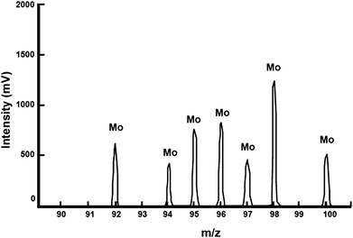
m/z ratio

Slide 26
Practice
Mass Spectra
Lucarelli Set 2
STAWA Set 21
Pearson Ch 2
Atomic Structure
Lucarelli Set 2
STAWA Set 8
Pearson Ch 2
Moles
Lucarelli 10.1-10.5 Set 16, Q1-5
STAWA Set 22-23
Pearson Ch 9.1-9.3

